Slide 1

Gym and Diet Planner
DATABASE MANAGEMENT SYSTEM
BY,
BHOOMI JAIN S RA2311056010282

Slide 2

1. Introduction

Slide 3
1.1 MOTIVATION
The demand for personalized fitness solutions is increasing. This trend is driven by the growing awareness of the importance of health and wellness among the general population. As people become more conscious of their physical and mental well-being, they seek out tools and services that can help them achieve their fitness goals.
In today's fast-paced world, individuals often struggle to find the time and motivation to maintain a consistent exercise routine. The availability of personalized fitness apps and programs can provide the necessary guidance and support to help users overcome these challenges. By offering customized workout plans, nutrition advice, and progress tracking, these solutions empower users to take control of their health and make sustainable lifestyle changes.
Moreover, the integration of emerging technologies, such as wearable devices and AI-powered analytics, further enhances the capabilities of these fitness solutions. The ability to collect and analyze user data allows for more personalized recommendations and real-time feedback, ultimately driving better engagement and long-term results.

Slide 4
1.2 Objective
This project aims to develop a user-friendly gym and diet planner that provides personalized recommendations for workouts and meal plans. The application utilizes data-driven algorithms to analyze user inputs and offer tailored guidance based on their specific needs and preferences.
By gathering information about an individual's fitness goals, current activity levels, and dietary habits, the application can generate personalized workout routines, meal plans, and progress tracking tools. This personalized approach helps users stay motivated and engaged, as they receive recommendations that are aligned with their unique circumstances and objectives. The app's ability to adapt to each user's evolving needs further enhances its effectiveness in supporting long-term lifestyle changes.

Slide 5

1.3 Problem Statement
Lack of Personalization
Inconsistent Motivation
Limited Data Insights
Existing fitness apps often provide generic recommendations that may not be suitable for everyone.
Maintaining motivation and consistency can be challenging, especially without personalized support.
Users may lack access to comprehensive data analysis and insights into their progress.

Slide 6
1.4 Challenges
Developing this app requires creating a seamless, intuitive user experience that encourages long-term engagement. Collecting and analyzing user data to provide personalized recommendations is another key challenge.
The app must also adapt to users' evolving needs over time. Ensuring data security and privacy is critical. Finally, effective marketing and user engagement strategies are needed to drive widespread adoption.
Additionally, the app will need to integrate with various fitness tracking devices and services to provide a comprehensive solution. Developing robust algorithms to analyze user data and deliver meaningful insights is crucial for the app's success.

Slide 7

2. Requirements
2.1 Requirement analysis
The Gym and Diet Planner application will be primarily developed using the Java programming language, which provides the necessary features and capabilities to build a comprehensive and scalable application.
The application will utilize a relational database management system (RDBMS) such as MySQL Key SQL requirements include creating, reading, updating, and deleting data, using SQL joins to combine data, leveraging SQL functions for data manipulation and analysis, ensuring data integrity through SQL transactions, and optimizing database operations with SQL views and stored procedures.

Slide 8
2.2 Hardware Requirements
The Gym and Diet Planner application will require a suitable hardware setup to ensure optimal performance and reliability. The application will be deployed on a server or cloud infrastructure that can handle the expected user load and data storage requirements, with sufficient processing power, memory, and storage capacity.
Clients accessing the application will need compatible devices such as desktop computers, laptops, or mobile devices with modern web browsers and at least a 1080p display resolution. For dedicated mobile app users, the devices should have at least 2GB of RAM and the latest operating system version. The application may also integrate with fitness tracking hardware like smart scales and fitness trackers.

Slide 9
2.3 SOFTWARE REQUIREMENTS
1
MY SQL
2
JAVA

Slide 10
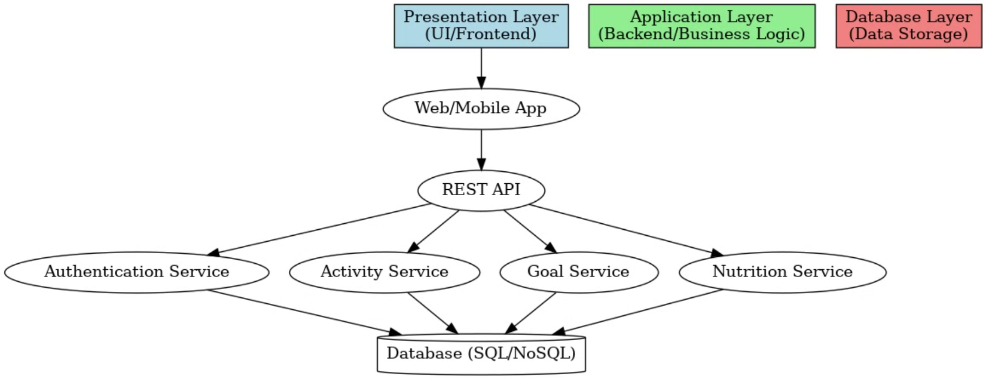
3. Architecture and design

Slide 11
4. ER Representation

Slide 12
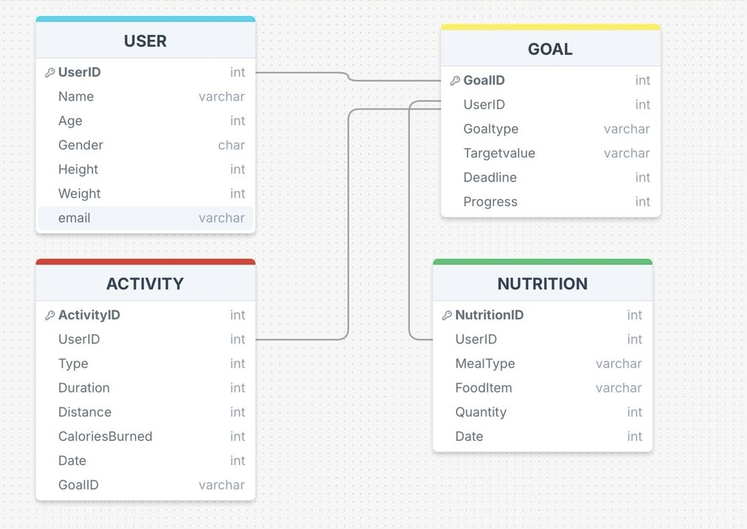
Relational Model
Title

Slide 13
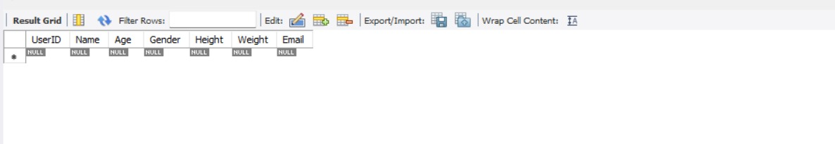
User ID Table

Slide 14
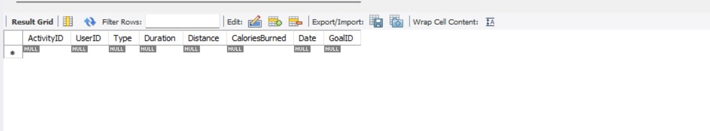
Activity ID Table

Slide 15
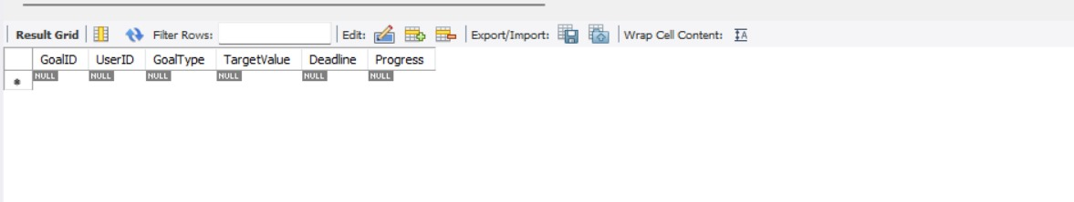
Goal ID Table

Slide 16
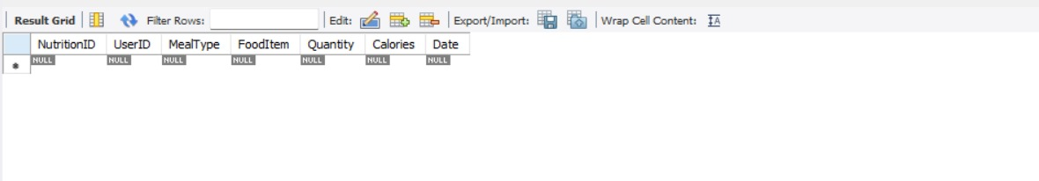
Nutrition Table

Slide 17
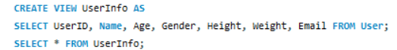
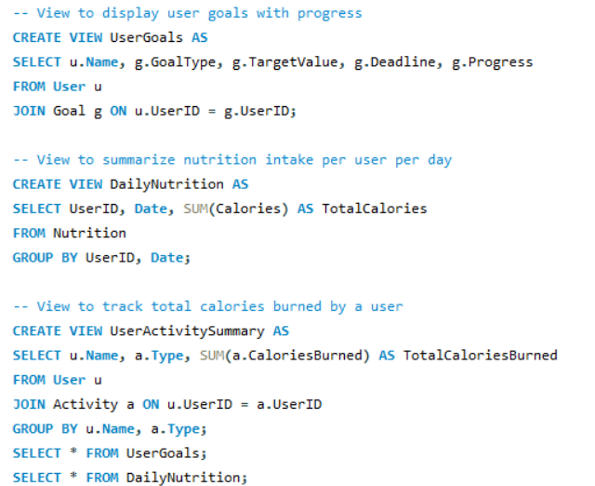
CREATING VIEWS

Slide 18
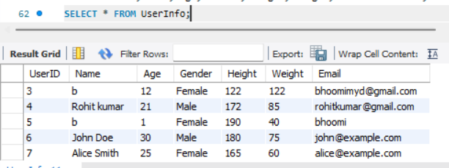
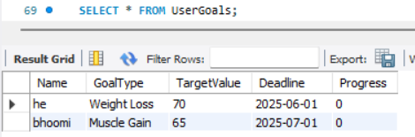
SAMPLE OUTPUT

Slide 19
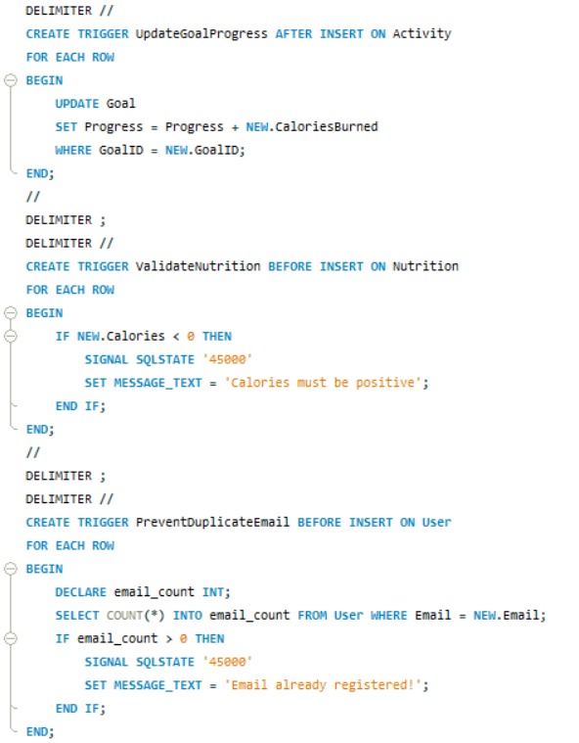
CREATING TRIGGERS

Slide 20
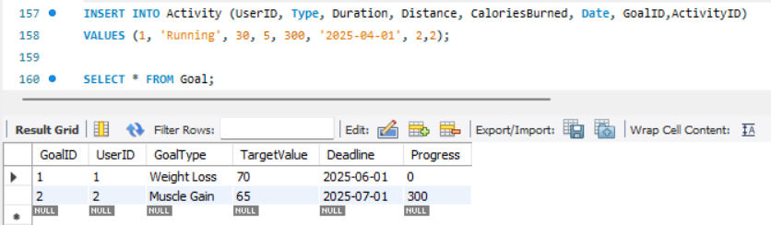
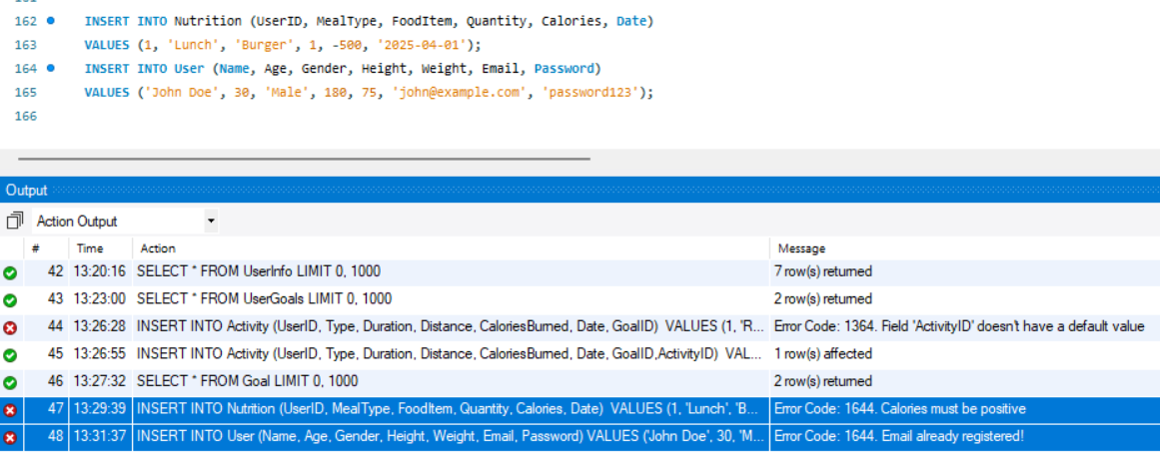
SAMPLE OUTPUT FOR TRIGGER

Slide 21
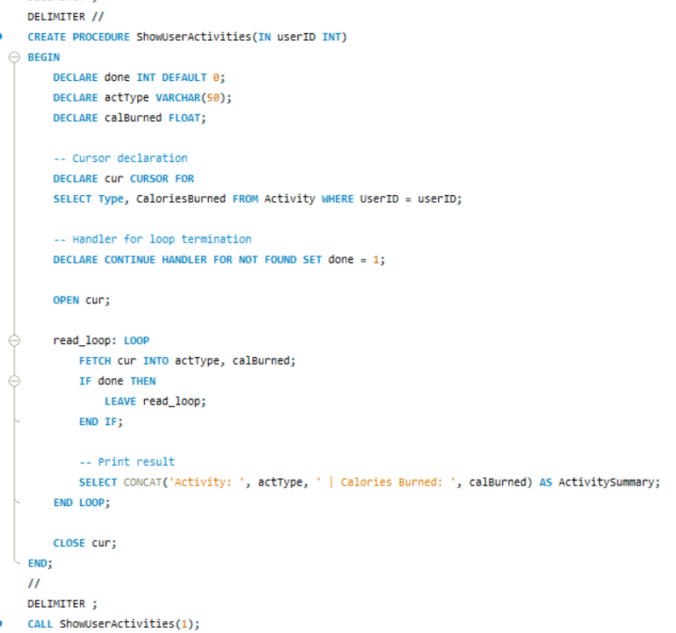
CREATING PROCEDURES AND CURSOR

Slide 22
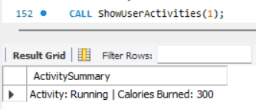
SAMPLE OUTPUT FOR CURSORS

Slide 23
PITFALL
Data Redundancy
Update Anomalies
Insertion Anomalies
Deletion Anomalies
Duplicate Entries
❌ Repeating data wastes space & causes inconsistencies
✅ Solved using 3NF normalization (linked tables by keys)
❌ Errors when only part of data is updated
✅ Foreign key constraints maintain consistency
❌ Can't add records unless other data exists
✅ Independent table design allows flexible insertion
❌ Deleting one record removes essential data
✅ Separated related data into distinct tables
❌ Same Email/User inserted more than once
✅ Trigger prevents duplicate user email

Slide 24
DEPENDENCY
Functional Dependency
When one column uniquely determines another column.
User Table UserID → Name, Age, Gender, Height, Weight, Email, Password (Each attribute is uniquely identified by UserID) Goal Table GoalID → UserID, GoalType, TargetValue, Deadline, Progress No transitive dependencies (e.g., Progress doesn’t depend on GoalType) | Activity Table ActivityID → UserID, Type, Duration, Distance, CaloriesBurned, Date, GoalID Fully functionally dependent on the primary key ActivityID Nutrition Table NutritionID → UserID, MealType, FoodItem, Quantity, Calories, Date All attributes depend only on NutritionID, with no indirect dependency

Slide 25
DEPENDENCY
Transitive Dependency
When one column depends indirectly on the primary key through another column.
EXAMPLE:
If Progress can be calculated from activities, then:
GoalID → Progress (transitively through Activity table)

Slide 26
NORMALIZING
1NF ensures that:
Each field contains only atomic values (no lists or sets).
Each record (row) is unique.
Let’s Check:-
User Table: Each column already holds atomic values (like Age, Gender, Height, etc.).
Activity Table: It also holds atomic values for Type, Duration, etc.
Same for Goal and Nutrition table.
Thus, all tables are already in 1NF.

Slide 27
NORMALIZING
Second Normal Form (2NF)
To achieve 2NF, we need to:
Eliminate partial dependencies, i.e., make sure non-key attributes depend on the entire primary key, not just part of it.
This is particularly relevant when we have a composite primary key.
The UserID, Activity, Goal, Nutrition Table has no partial dependencies.
Therefore, there's no need to change anything for 2NF. All tables meet the requirements of 2NF as well.

Slide 28
NORMALIZING
To achieve 3NF, we need to:
Remove transitive dependencies, i.e., non-key attributes should depend only on the primary key, not on other non-key attributes.
User Table: All non-key attributes (Name, Age, Gender, etc.) depend only on the primary key UserID. No transitive dependencies.
Goal Table: Attributes like GoalType, TargetValue, etc. depend directly on GoalID. No partial or transitive dependencies.
Activity Table: Each column depends solely on ActivityID. Fully normalized with no redundant data.
Nutrition Table: MealType, FoodItem, Calories, etc. depend on NutritionID. No derived or transitive attributes.

Slide 29

Thank You
We appreciate your time and consideration. We believe this gym and diet planner has the potential to transform the fitness industry.

